Slide 1
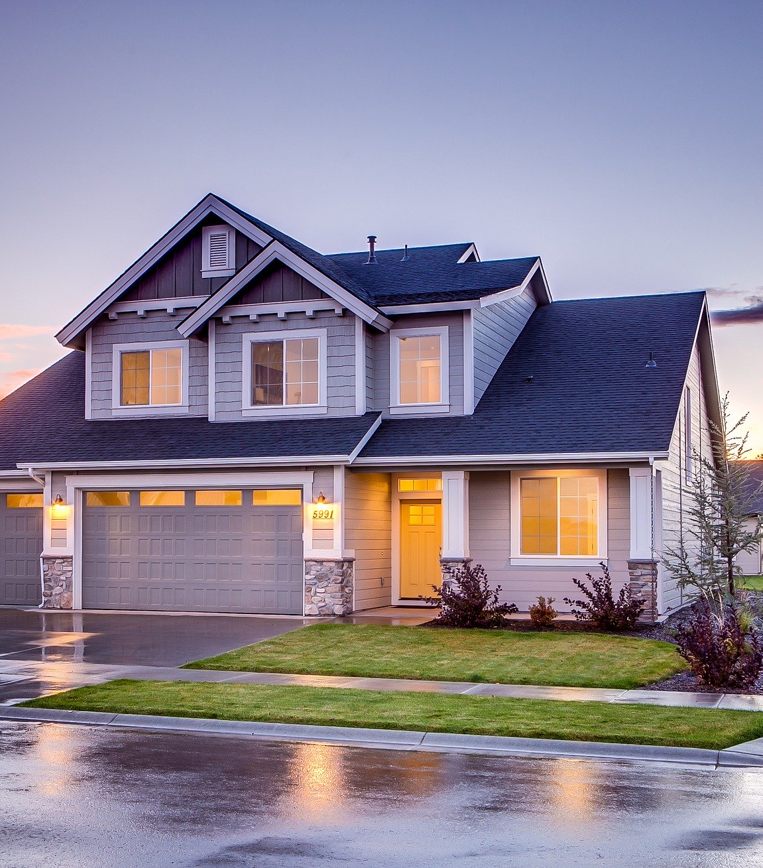
Identifying ‘Undervalued’ Properties
Modelling historical sales-data on fixed and renovate-able property features to identify future buying opportunities

Slide 2


Company Mission
Provide an exceptional end-to-end residential real-estate service

Slide 3

The problem
While moving toward mission, company needs to identify undervalued residential stock on market
Objective to create value in these properties for re-selling at profit
Need reliable method to identify ‘undervalued’ stock

Slide 4

The solution
Use machine learning using property feature and historical sale data to create an algorithm that reliably estimates the value of residential houses based on:
Fixed features
Renovate-able features

Slide 5


The data
Data Cleaning
Null values
LotFrontage 259 → imputed with median
Street → alley to No alley access
Transformations
LotFrontage → log transformation
LotArea → log transformation
GrLivArea → log transformation
Feature Creation
Ratio bed to bath
Total full baths
Total half baths
Recoding
Condition1 → reduced number of classes
ExterQual → to quasi-interval variable
Ames Housing dataset
1461 properties in the Ames, Iowa region
80 property features
Fixed (e.g. size of lot, slope of lot, general living area etc.,)
Renovate-able (e.g. overall condition, kitchen quality etc.,)
Sale Price
Year of sale
Sale price

Slide 6
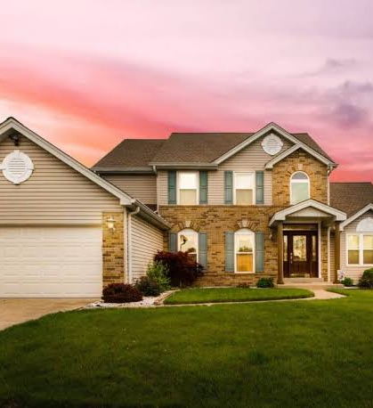
Fixed Features

Slide 7
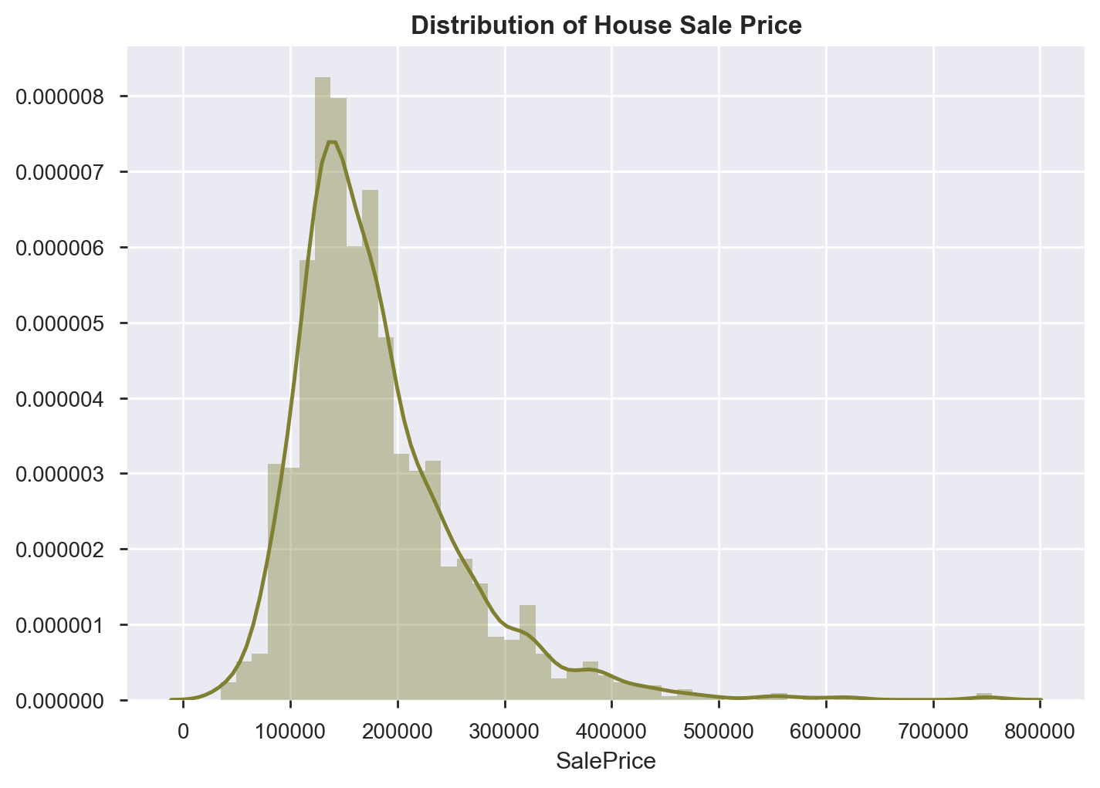

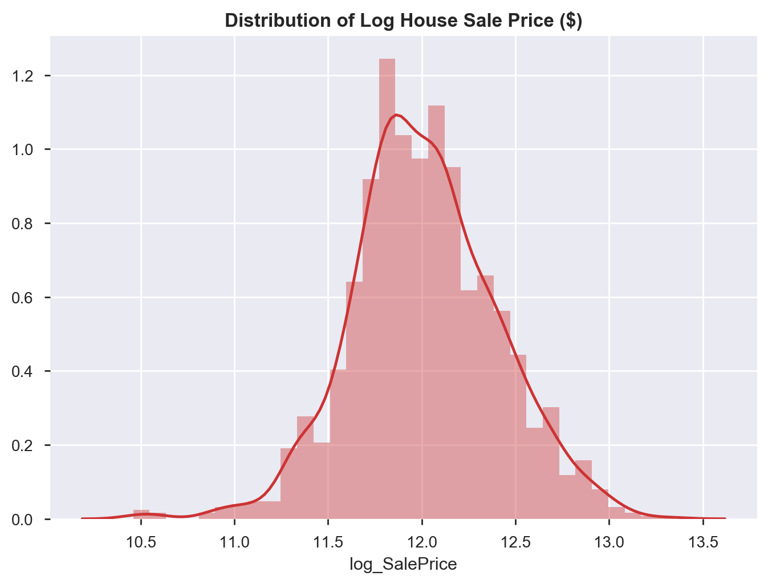
Median Sale price was $162,000. Sale price showed a positive skew. Therefore, a log transformation was chosen as the target.
Sale price is positively skewed
Log transformation improves normality
$162,000
Target is the log_SalePrice
Median property price

Slide 8
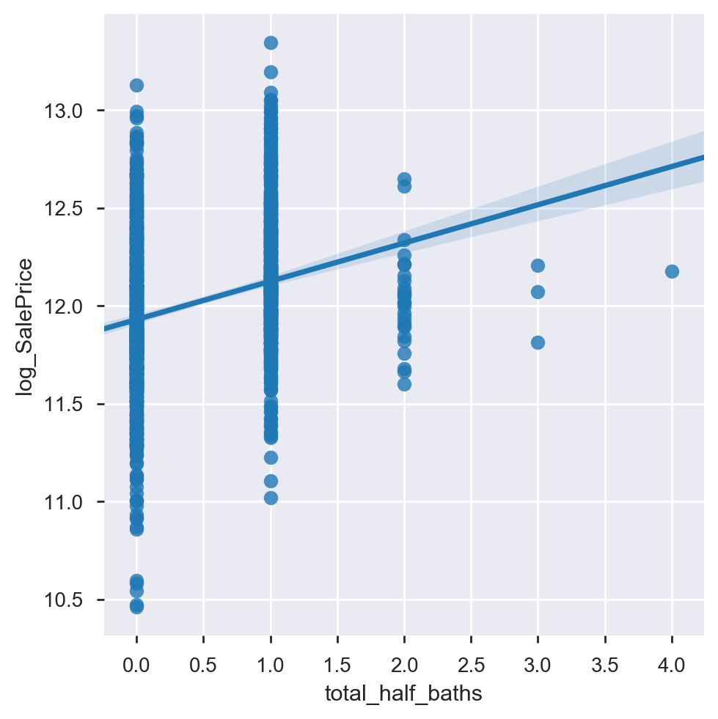
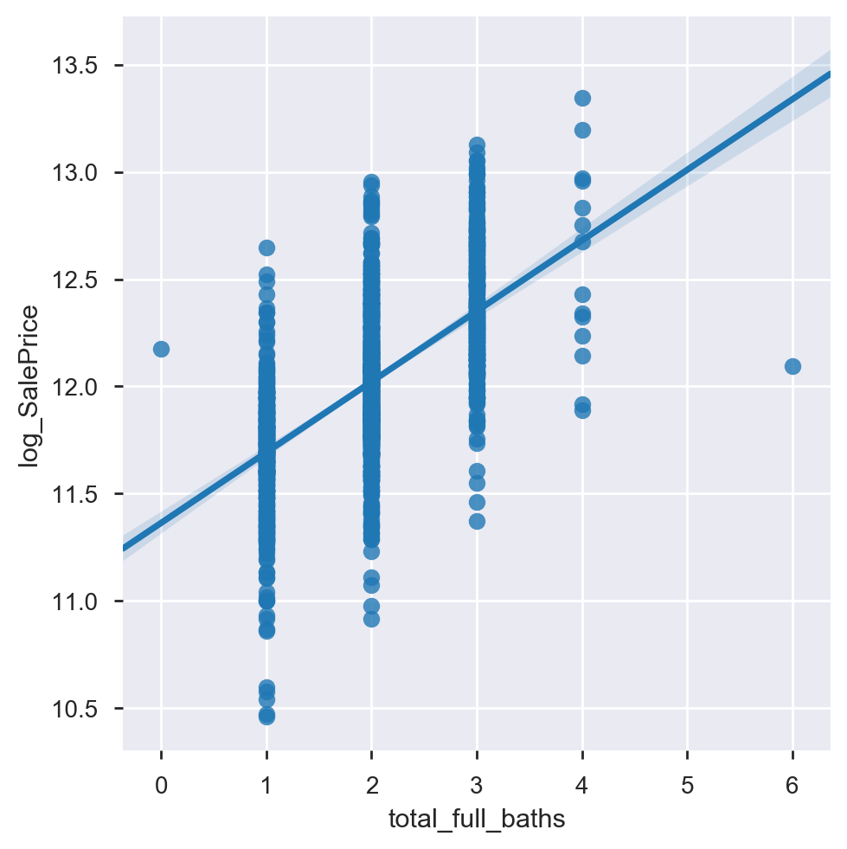
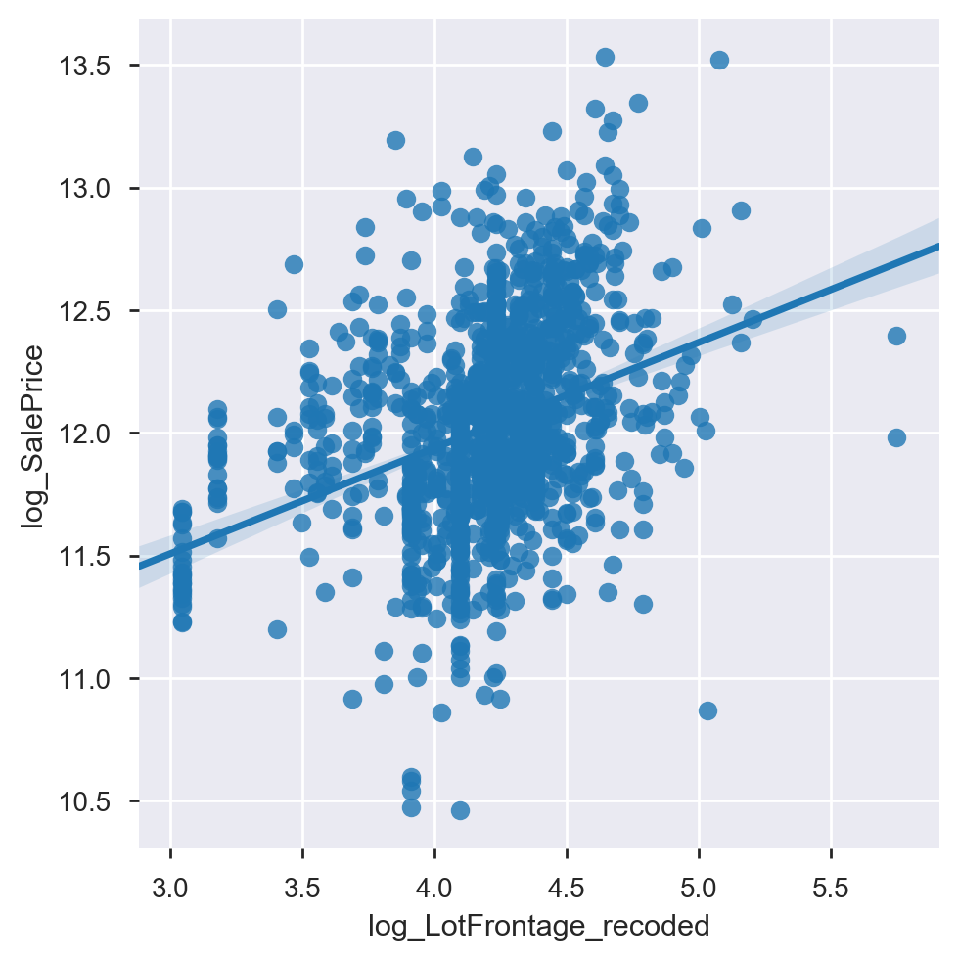
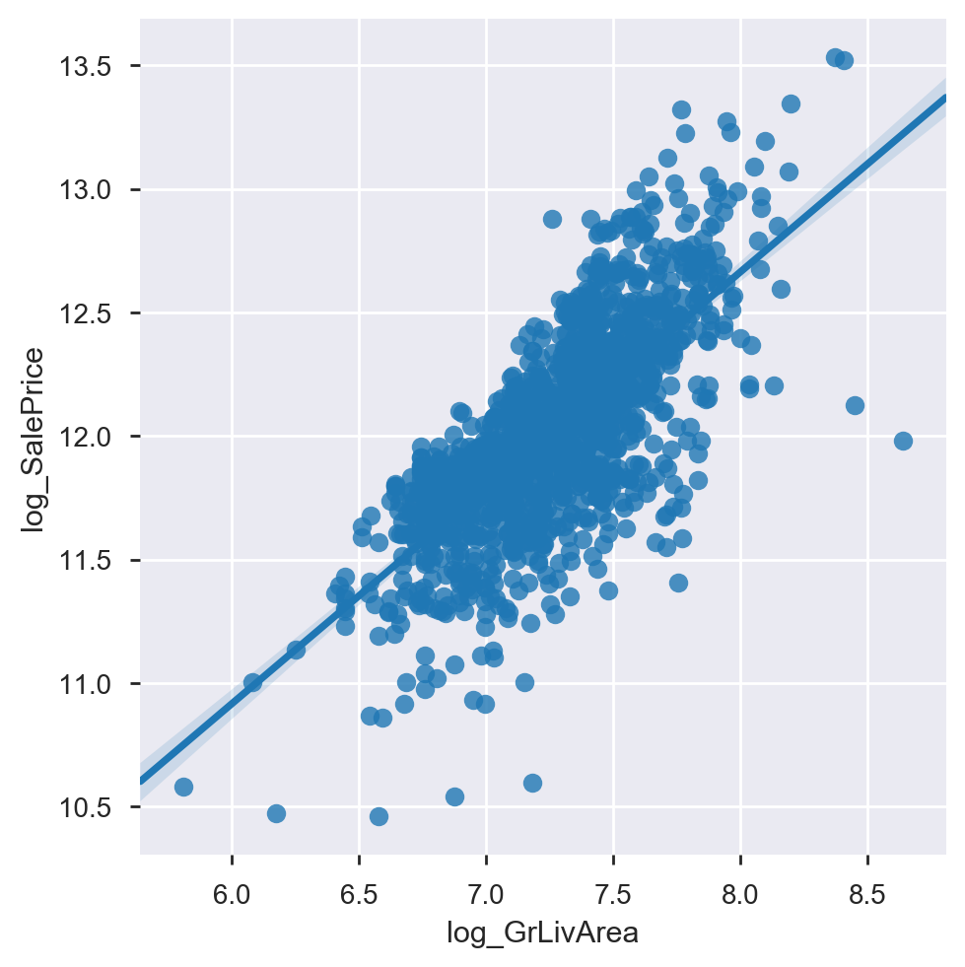
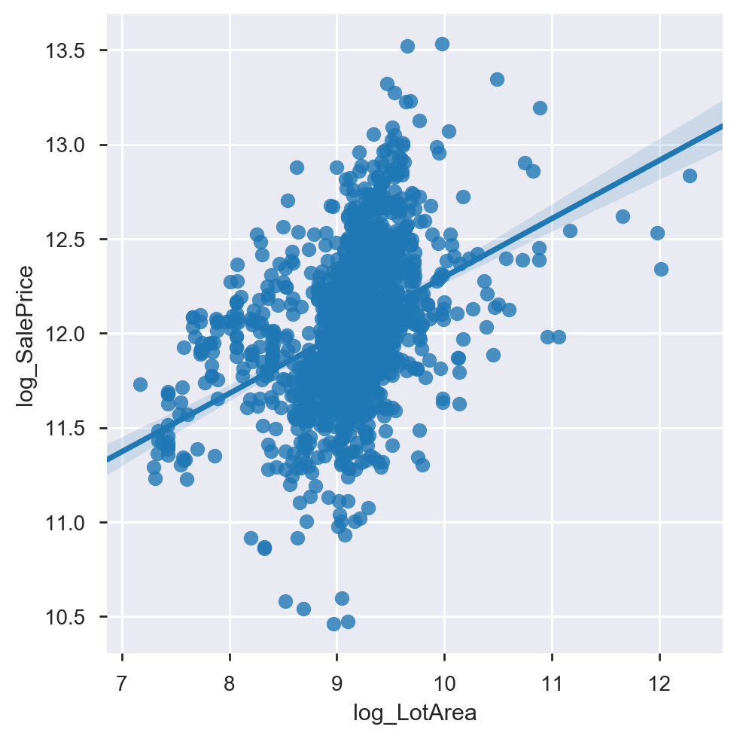
Investigation of variables showed generally expected relationships to the (log) sale price
Total Half Baths
Total Full Baths
Log Lot Frontage
Log General Living Area
Log Living Area

Slide 9
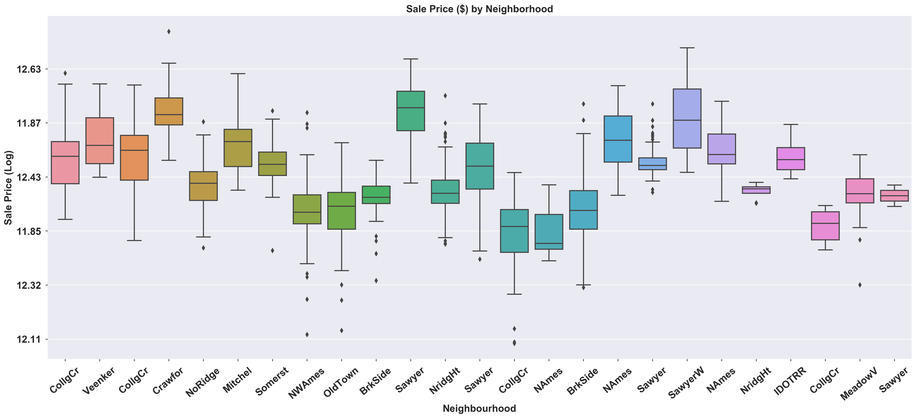



(Log) sale price as expected varies across neighbourhoods, with more sought after neighbourhoods showing higher prices.

Slide 10
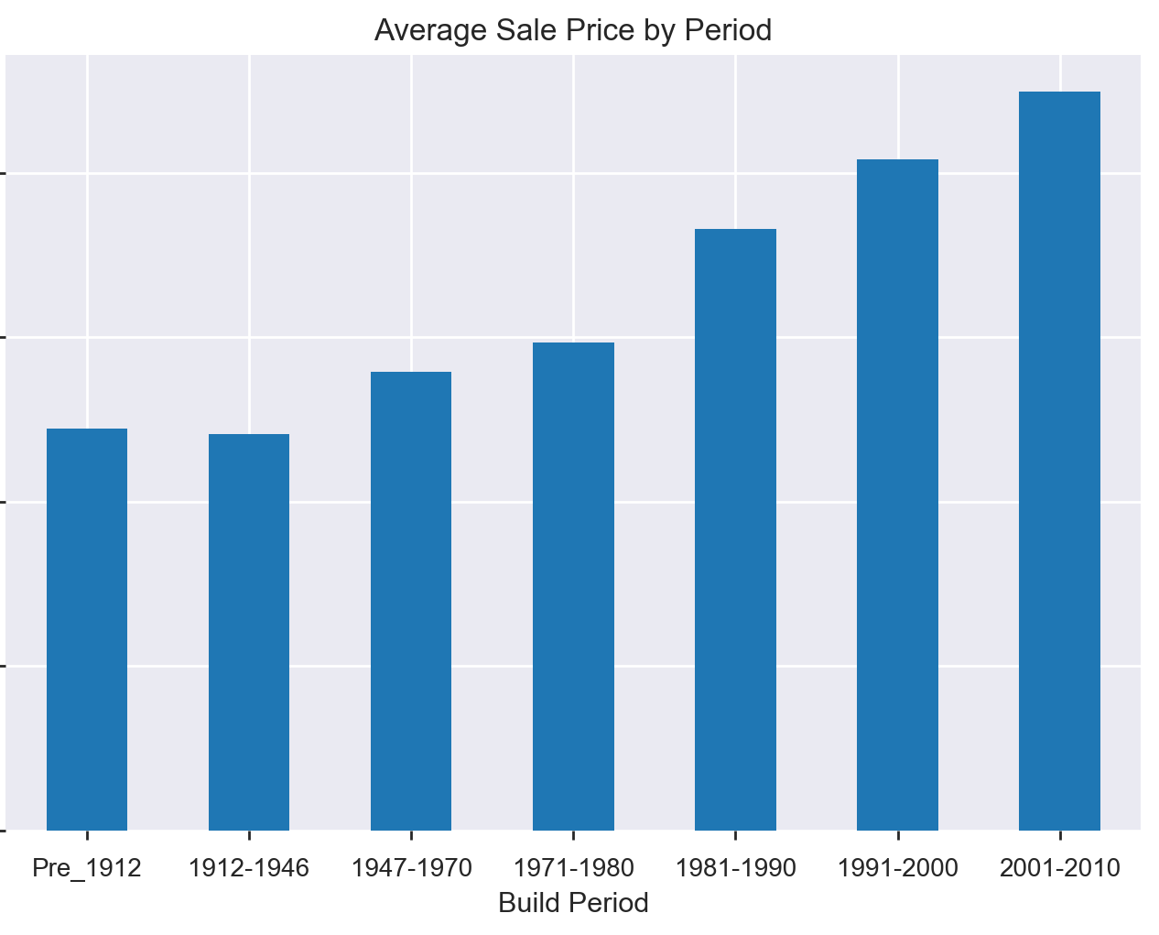
Properties built in later periods tend to have higher sales price. This likely represents more recent properties being designed for modern requirements around living and lower maintenance costs
Upward Trend in price

Slide 11
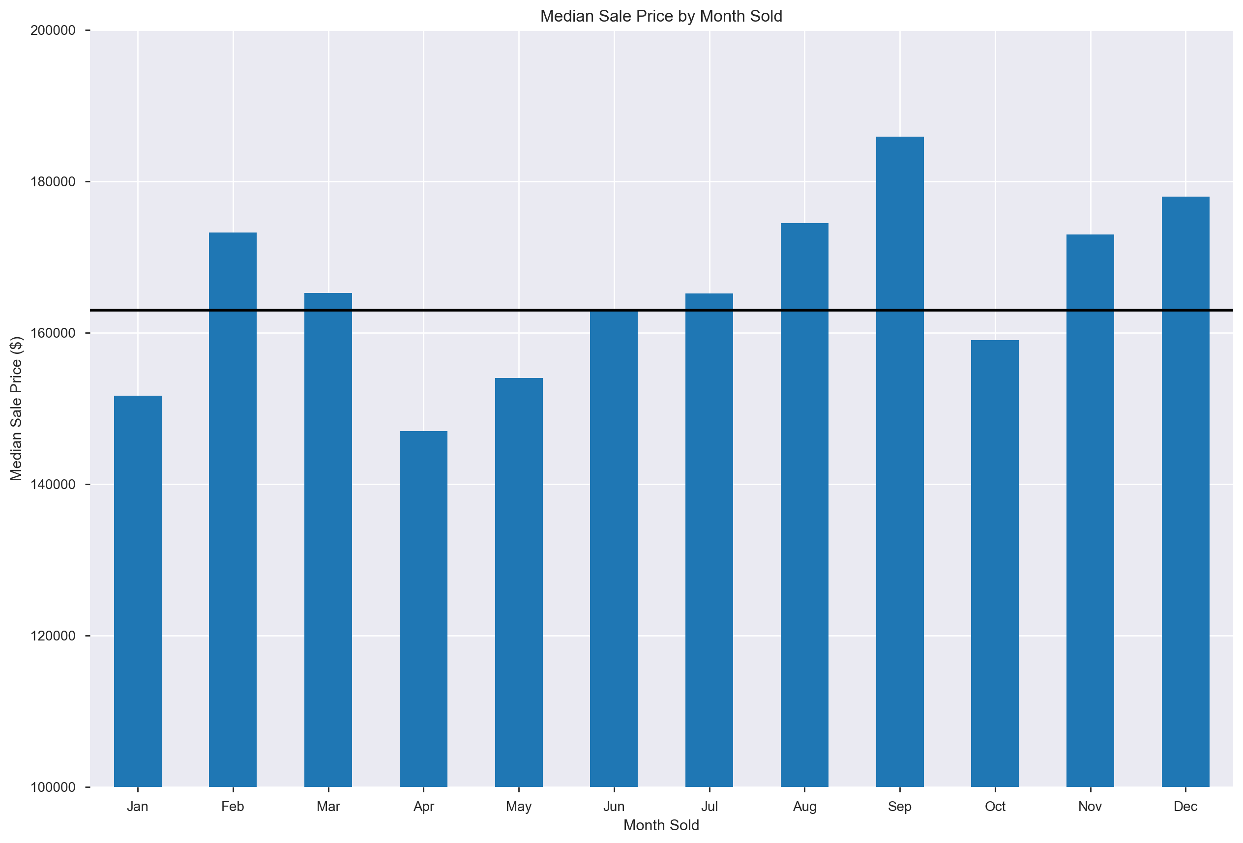
There is also evidence of seasonality in sale price with higher sale prices generally recorded in the latter half of the year, peaking in September
Upward trend in price from April to September

Slide 12

Three fixed model tests were tested with similar results yielded from Linear and Lasso Regression. Linear regression showed better overall performance on cross-validation and predicting 2010 prices
Cross-Validated approach includes all data
Selected Model
 | Linear Regression | Lasso Regression | Ridge Regression
Cross-Validated Model (CV=10) Mean R2 (Std) | 83.35% (2.12%) | 82.97% (2.04%) | 79.89% (7.33%)
Pre-2010 Model R2 | 85.05% | 85.08% | 84.48%
Training model on pre-2010 data with 2010 data used as holdout for testing

Slide 13
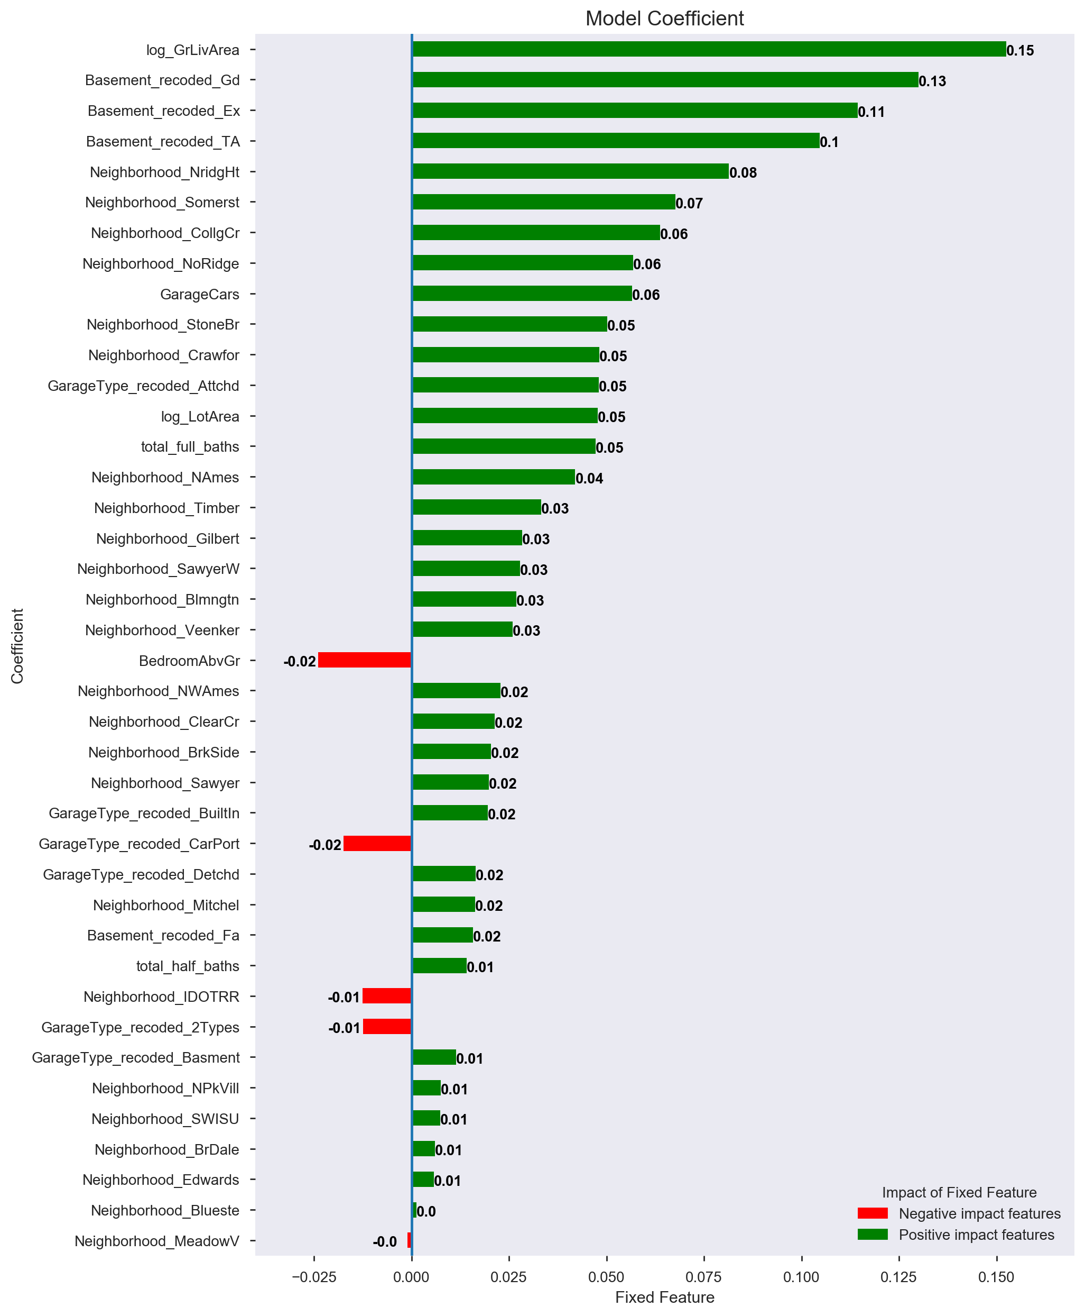
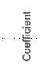
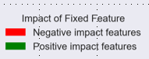
General Living Area size is the strongest predictor of sale price (log), with the height of the basement also (surprisingly) a key predictor. College Creek, Northridge Heights, Somerset, and Northridge are key neighborhoods contributing to sale price prediction

Slide 15

Renovate- able Features

Slide 16
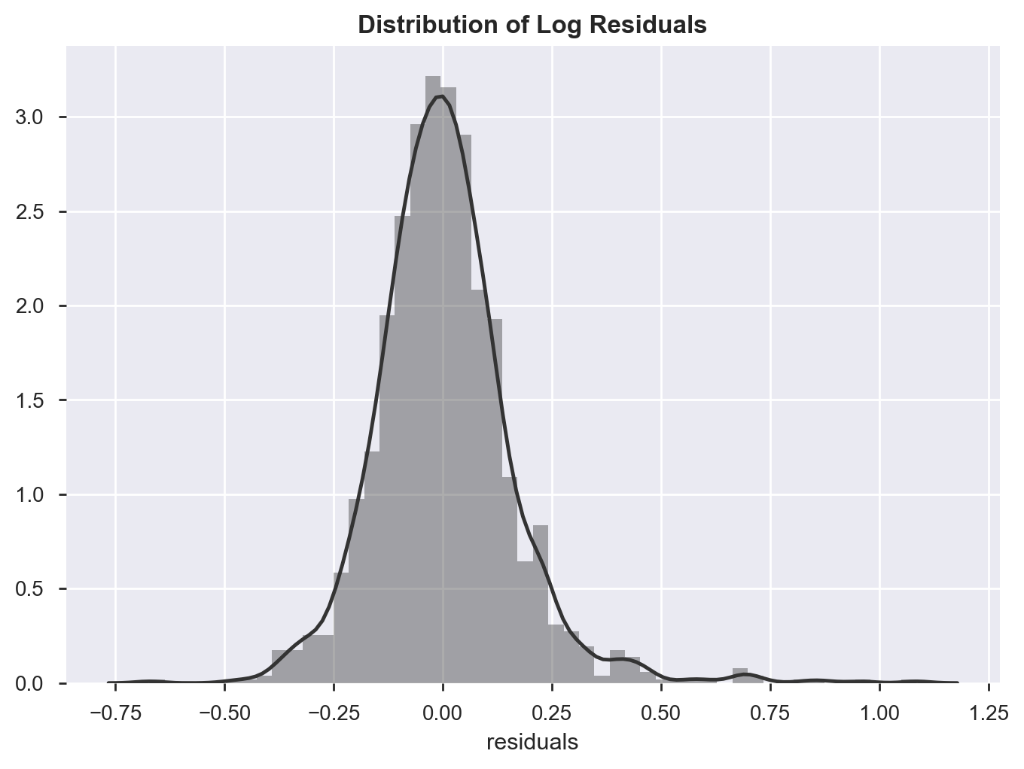
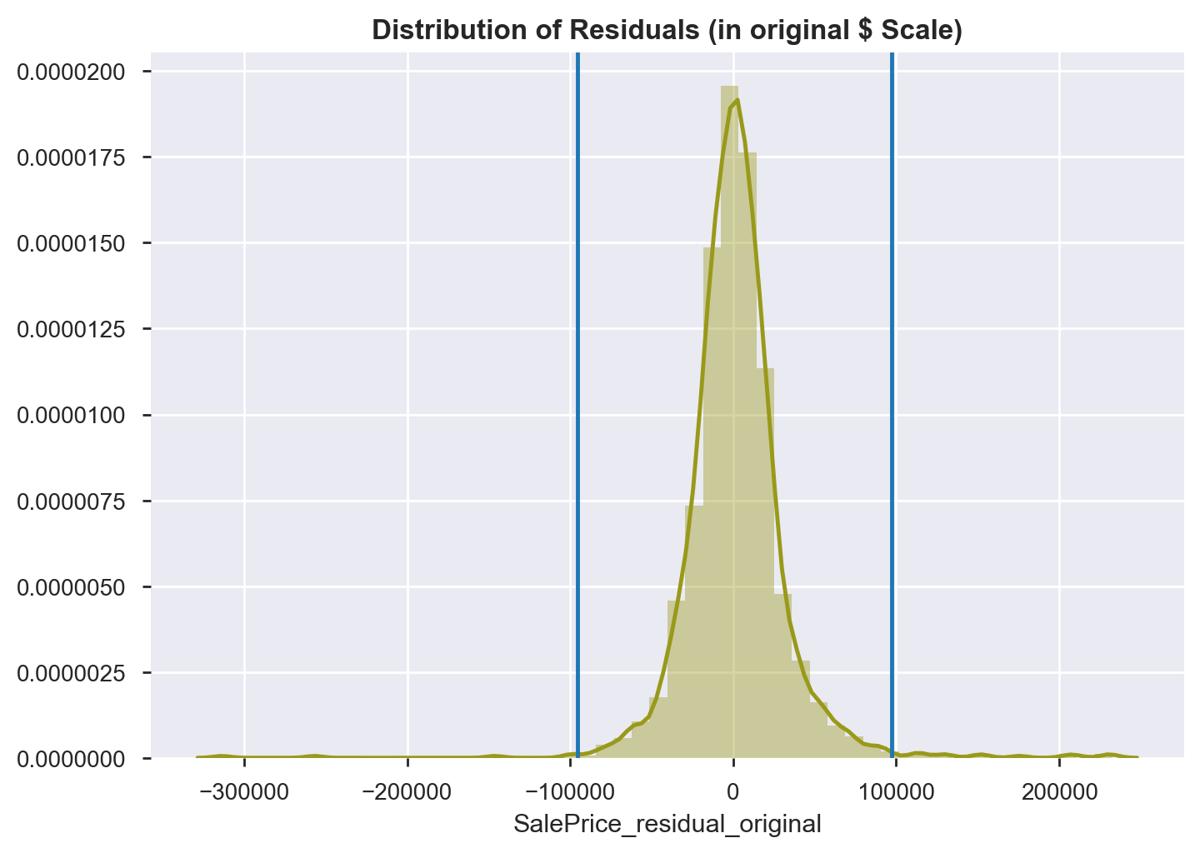
The residuals from the fixed model were used. Target transformed to original scale unit to aid interpretation as normality not impacted.
Conversion to Original $ Units
As there were some large residuals, a decision was made to remove extreme outliers (IQR Range * 3 denoted by lower and upper blues lines.)

Slide 17
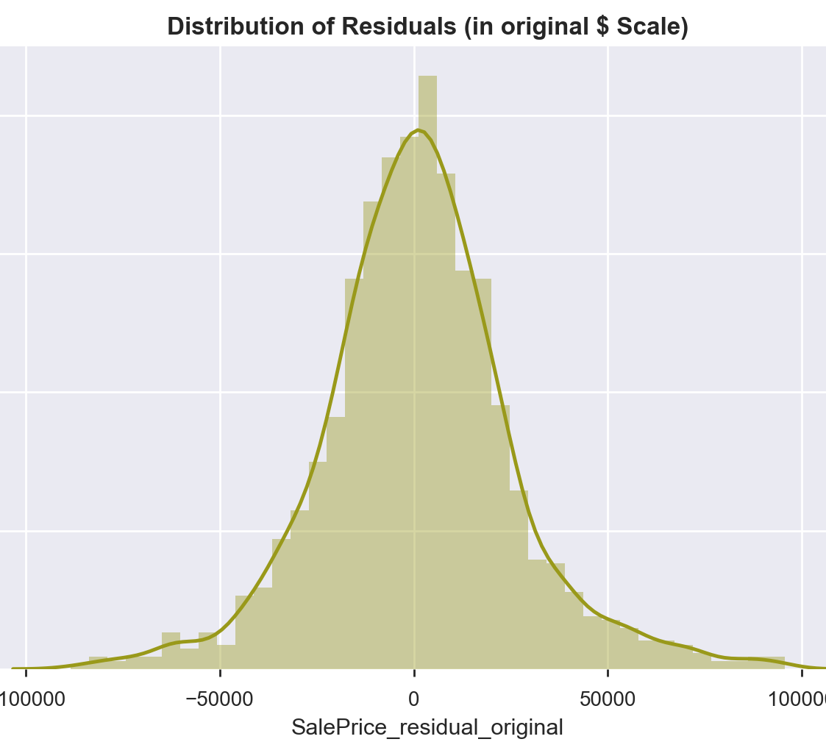
Removal of extreme residuals resulted a loss of 35 properties for modelling but resulted in a normally distributed target, which should help improve modelling accuracy and generalisation

Slide 18
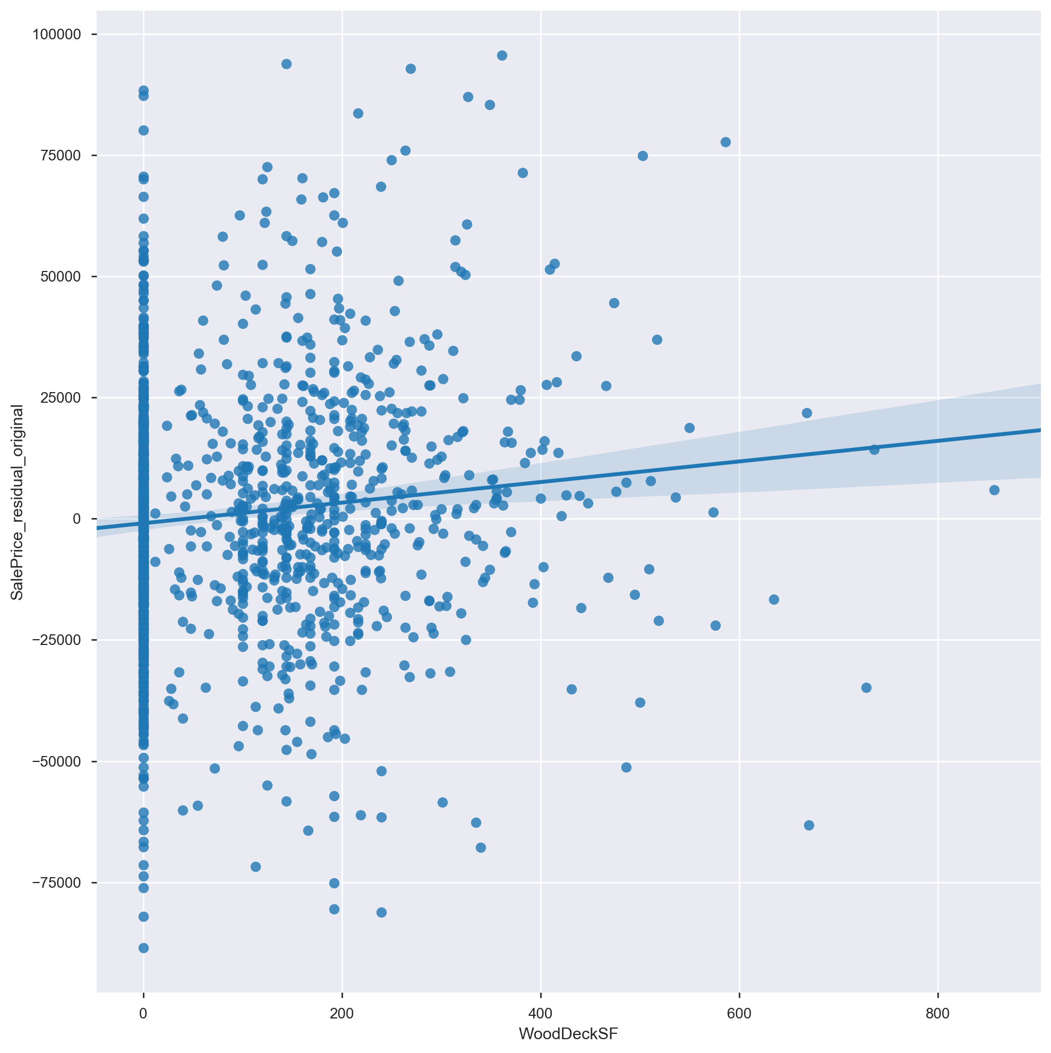
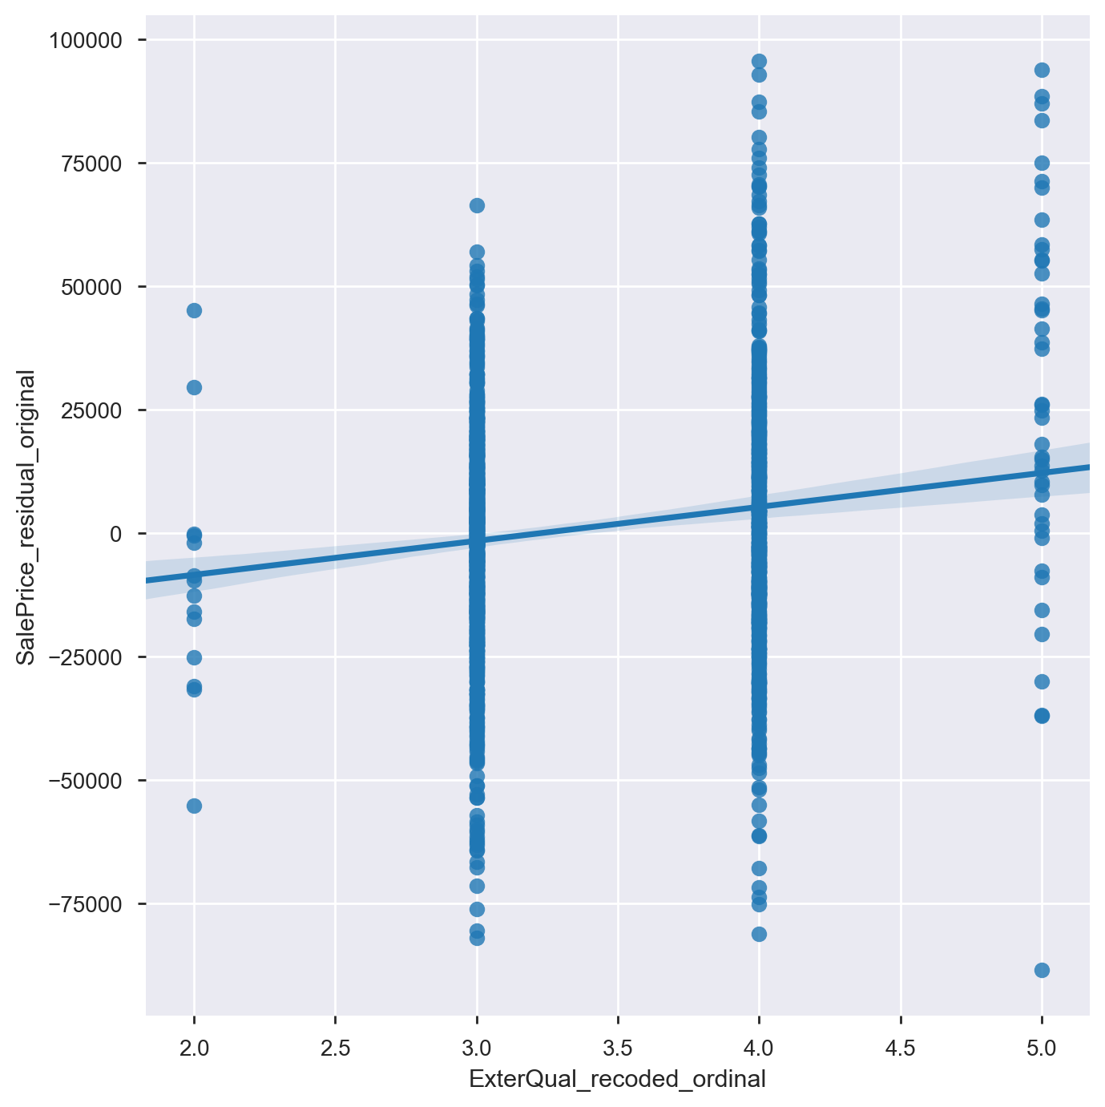
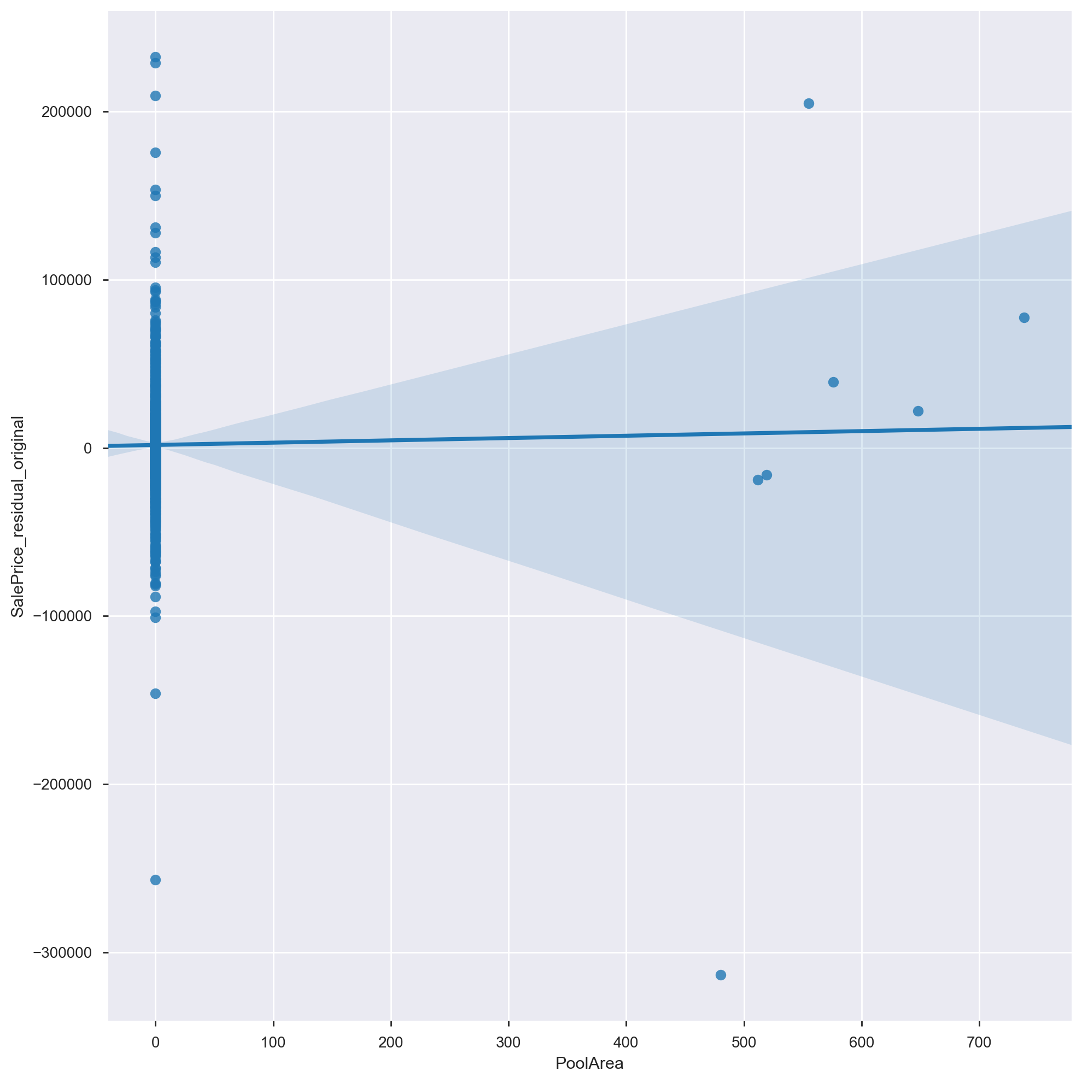
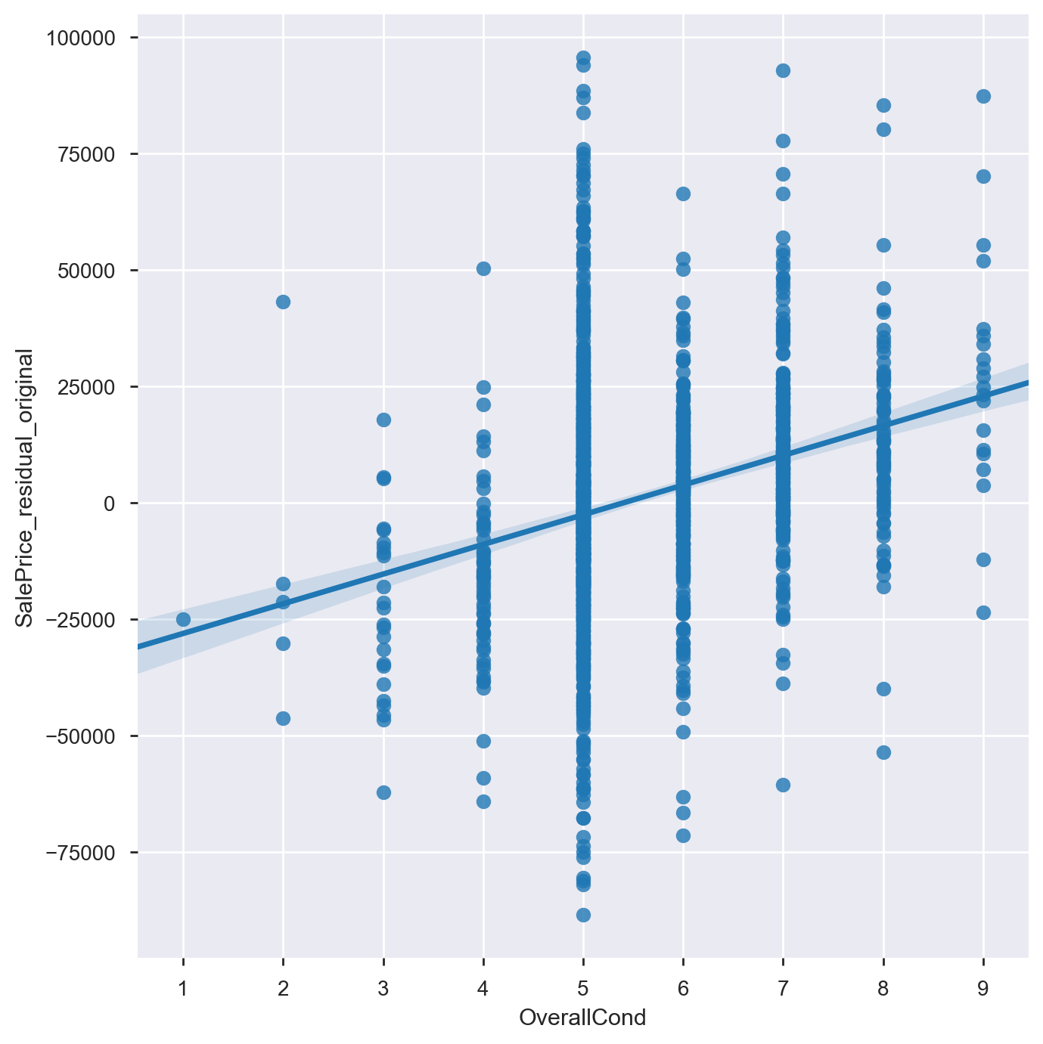
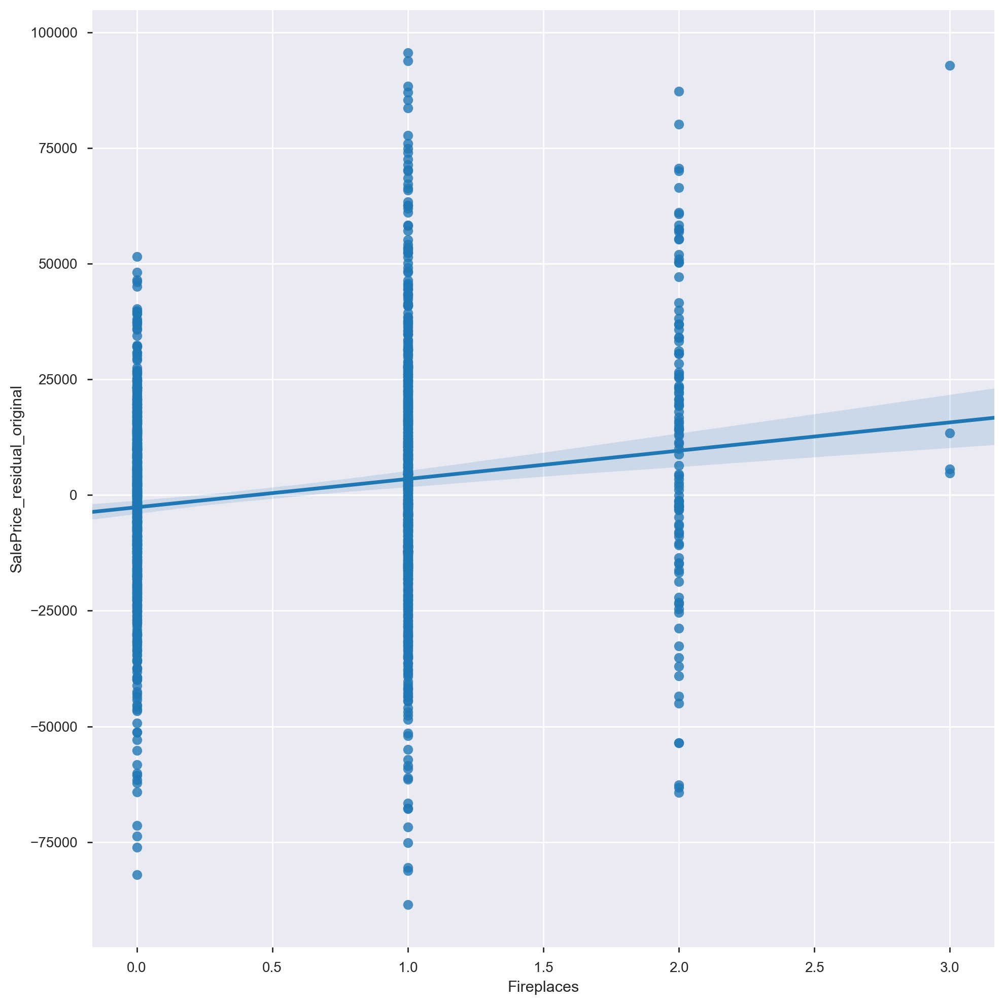
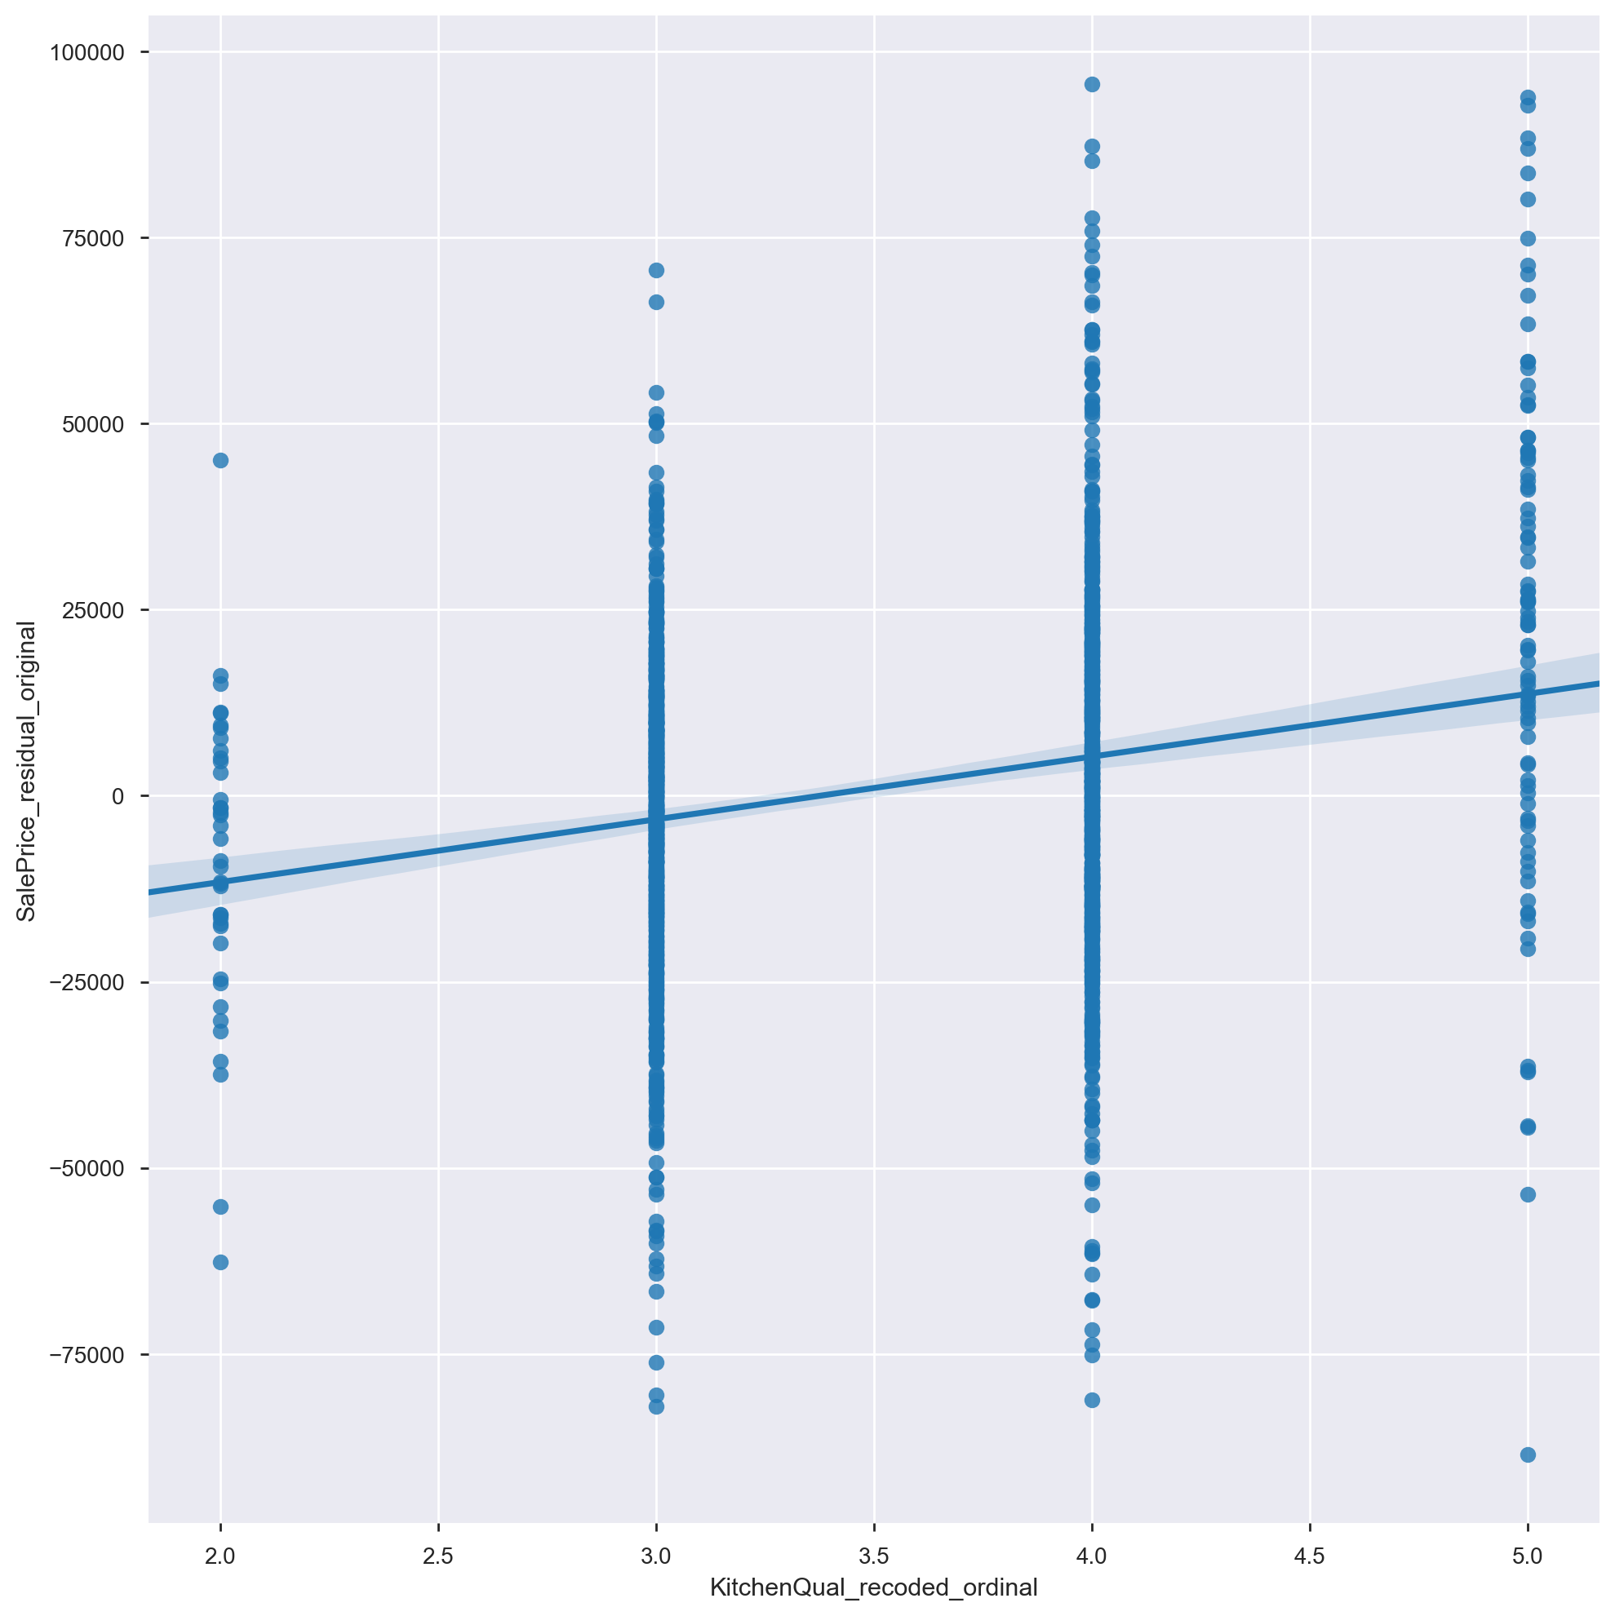
Exploration of relationships to target suggested most renovate-able features had some positive contribution to predicting sale price residuals
Wood Deck Size (Sqft)
External Quality
Pool Area (Sqft)
Overall Condition
FirePlaces (n)
Kitchen Quality

Slide 19
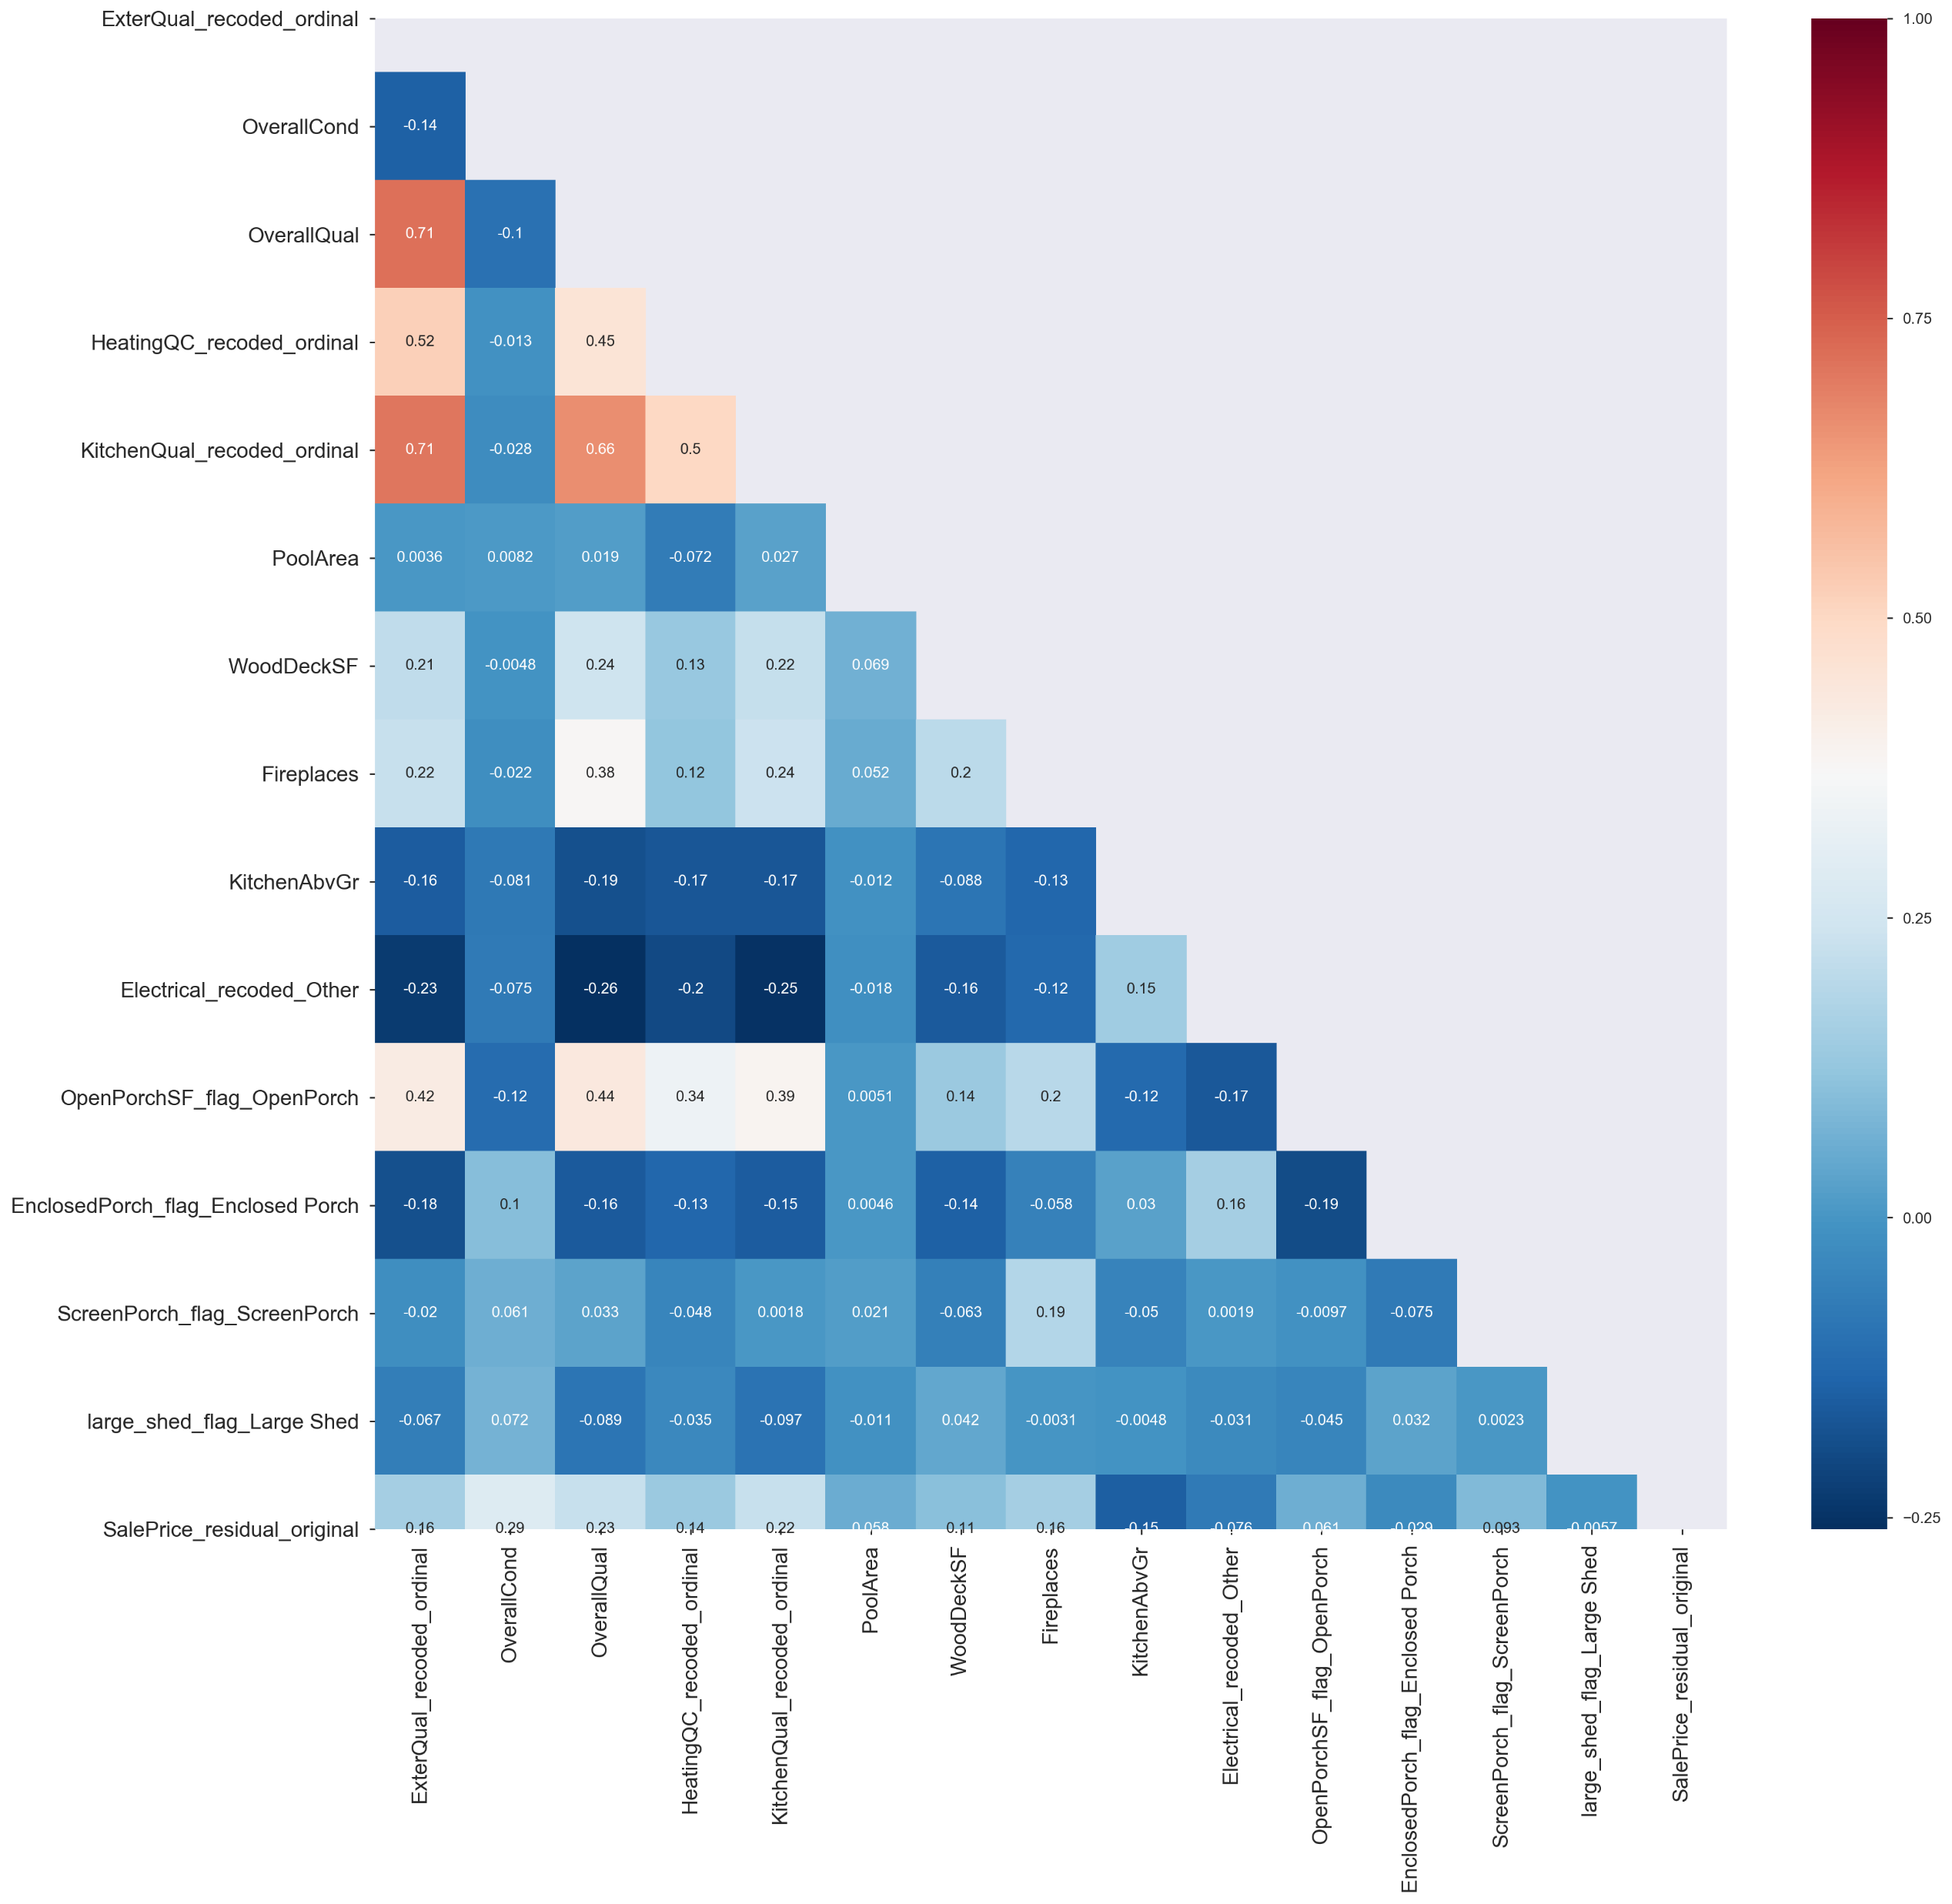
Investigation of correlations matrix among features suggests that multi-collinearity unlikely to be an issue

Slide 20
A linear and lasso regression model yielded similar results, with lasso being slightly better. However, performance was ultimately low, with less than 15% of variance in sale price residuals explained by renovate-able features
 | Linear Regression | Lasso Regression
Cross-Validated Model (CV=10) Mean R2 (Std) | 14.47% (7.51%) Predicted K-Fold cross-validation R2 scores: [-0.04, 0.13, 0.12, 0.13, 0.15, 0.19, 0.13, 0.18, 0.25, 0.21] | 14.59% (7.32%) Predicted K-Fold cross-validation R2 scores [-0.04, 0.14, 0.12, 0.13, 0.15, 0.20, 0.13, 0.17, 0.25, 0.21]

Slide 21
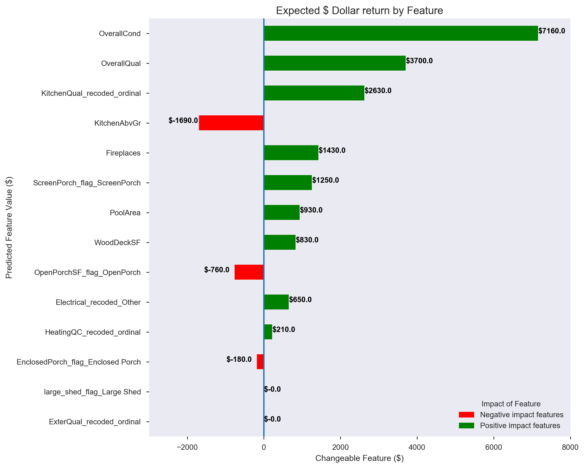
Overall condition and overall quality showed the highest expected ROI
$ Values can be interpreted as an increase in rating by one standard deviation unit on the Overall Condition scale (1.1081) is associated with an expected return of $7,160 (all other features remaining equal)

Slide 22

How to use this information

Slide 23
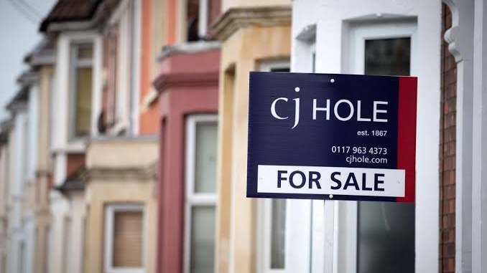
There are opportunities to use the two models to identify ‘under-valued’ properties and estimate ROI from renovating
Fixed Features Model
Use the fixed feature model help identify potentially 'undervalued' properties.
Where expected ROI is more than price to purchase/make changes then ‘undervalued’ property
Fixed features are more of a driver of sale price then renovate-able features
Renovate-able Features Model
Calculate the expected ROI if improvement made in respective property feature
Caution on this model: Recommend only make decision where substantial expected value increase is at least 3x that of estimated renovation cost

Slide 24

When considering fixed features, focus on high impact fixed features but also try to capture as many possible sale price drivers as possible
Size of General living area
Height/Quality of Basement:
Focus on properties with basements more than 90cm (rated as good or excellent)
Target College Creek, Northridge Heights, Somerset and Northridge
Identifying undervalued properties in these neighborhoods may provide greater opportunities to improve value

Slide 25
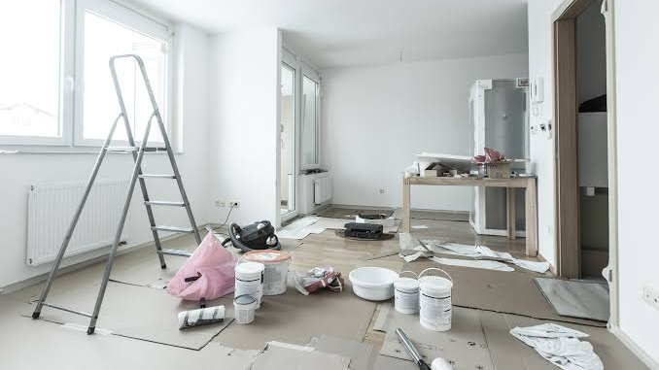
When renovating…
Focus on improving overall condition and quality
Only basic improvements to existing kitchen
Notes:
recommend focus improving the overall condition and quality of a property rather than adding specific features to a property such as a pool or changing the electrics as these have less of an impact on price
recommend only basic improvements to existing kitchen as kitchen quality is a positive contributing feature but the expected ROI is low.

Slide 26

Other observations
Seek to sell in latter half of year (preferably September)
Focus on newer properties as this has a known impact on property price

Slide 27

Thank you

